Slide 1
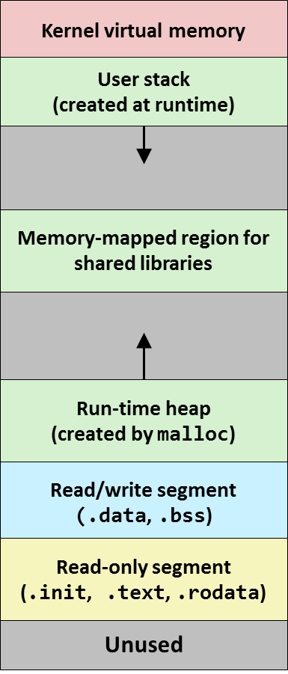
Memory Abstraction Recap: Variables and Memory

Slide 2
Lecture Outline
Motivating Example
Variables and Memory
Pointers and Memory Allocation
Data Types and Alignment
Composite Data Structures
Parameter Passing
Summary

Slide 3
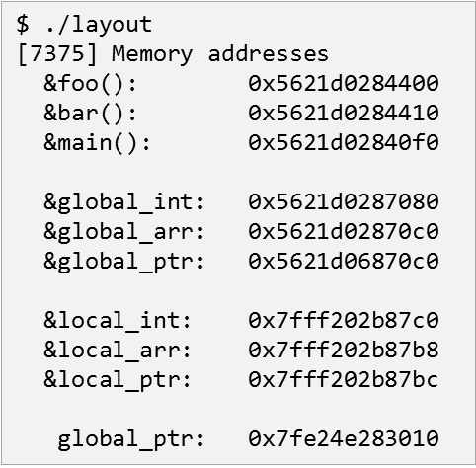
Where do Functions & Variables go?

Slide 4
Where do Functions & Variables go?
…
int global_int = 0x1;
int global_arr[N];
int *global_ptr; int *shared_int;
void foo(void) { … }
void bar(unsigned int key, int val) { … }
int main(int argc, char *argv[])
{
int local_arr[1024];
int local_k, local_v;
…
printf("[%d] Memory addresses\n"
" &foo(): %p\n"
" &bar(): %p\n"
" &main(): %p\n"
"\n"
" &global_int: %p\n"
" &global_arr: %p\n"
" &global_ptr: %p\n"
"\n"
" &local_int: %p\n"
" &local_arr: %p\n"
" &local_ptr: %p\n"
"\n"
" global_ptr: %p\n"
" shared_ptr: %p\n“ "\n\n",
pid,
&foo, &bar, &main,
&global_int, &global_arr, &global_ptr,
&local_arr, &local_k, &local_v,
global_ptr, &shared->shared_int);
…
}
layout.c

Slide 5
Where do Functions & Variables go?
Older Linux kernels without address space layout randomization or address space layout randomization disabled
$ make layout
gcc -Wall -O2 -o layout layout.c –lpthread $ ./layout [ 4914] Memory addresses
&foo(): 0x4007c0
&bar(): 0x4007d0
&main(): 0x4005a0
&global_int: 0x601060
&global_arr: 0x6010c0
&global_ptr: 0xa010c0
&local_int: 0x7fffe4b12780
&local_arr: 0x7fffe4b12920
&local_ptr: 0x7fffe4b12924
global_ptr: 0x7efedd940010
shared_ptr: 0x7efeddf7e020
…
$ ./layout [ 4919] Memory addresses
&foo(): 0x4007c0
&bar(): 0x4007d0
&main(): 0x4005a0
&global_int: 0x601060
&global_arr: 0x6010c0
&global_ptr: 0xa010c0
&local_int: 0x7ffcf8698640
&local_arr: 0x7ffcf86987e0
&local_ptr: 0x7ffcf86987e4
global_ptr: 0x7f6c0ce11010
shared_ptr: 0x7f6c0d44f020
…

Slide 6
Where do Functions & Variables go?
Recent Linux kernels with address space layout randomization (ASLR)
$ make layout
gcc -Wall -O2 -o layout layout.c –lpthread $ ./layout [16072] Memory addresses
&foo(): 0x56272dead430
&bar(): 0x56272dead440
&main(): 0x56272dead100
&global_int: 0x56272e2b00e0
&global_arr: 0x56272deb00e0
&global_ptr: 0x56272deb00c8
&local_int: 0x7fff0c9334b0
&local_arr: 0x7fff0c9334a8
&local_ptr: 0x7fff0c9334ac
global_ptr: 0x7f70fc85c010
shared_int: 0x7f70fce9a020
…
$ ./layout [16073] Memory addresses
&foo(): 0x5576a2907430
&bar(): 0x5576a2907440
&main(): 0x5576a2907100
&global_int: 0x5576a2d0a0e0
&global_arr: 0x5576a290a0e0
&global_ptr: 0x5576a290a0c8
&local_int: 0x7ffe2ad75630
&local_arr: 0x7ffe2ad75628
&local_ptr: 0x7ffe2ad7562c
global_ptr: 0x7f96662bf010
shared_int: 0x7f96668fd020 …

Slide 7
Where do Functions & Variables go?
$ ./layout 2 [16074] Memory addresses
&foo(): 0x55d2942ea430
&bar(): 0x55d2942ea440
&main(): 0x55d2942ea100
&global_int: 0x55d2946ed0e0
&global_arr: 0x55d2942ed0e0
&global_ptr: 0x55d2942ed0c8
&local_int: 0x7ffd6a6ad640
&local_arr: 0x7ffd6a6ad638
&local_ptr: 0x7ffd6a6ad63c
global_ptr: 0x7f8e5c5a1010
shared_int: 0x7f8e5cbdf020
[16075] Memory addresses
&foo(): 0x55d2942ea430
…
&local_int: 0x7ffd6a6ad640
&local_arr: 0x7ffd6a6ad638
&local_ptr: 0x7ffd6a6ad63c
global_ptr: 0x7f8e5c5a1010
shared_int: 0x7f8e5cbdf020 …
Multi-process version
creates n clones of itself
all clones repeatedly increment two variables global_int and shared_int
How is that possible?
… [16074] global_int = mem[0x55d2946ed0e0] = 0; shared_int = mem[0x7f8e5cbdf020] = 0
[16075] global_int = mem[0x55d2946ed0e0] = 0; shared_int = mem[0x7f8e5cbdf020] = 1
[16074] global_int = mem[0x55d2946ed0e0] = 1; shared_int = mem[0x7f8e5cbdf020] = 2
[16074] global_int = mem[0x55d2946ed0e0] = 2; shared_int = mem[0x7f8e5cbdf020] = 3
[16075] global_int = mem[0x55d2946ed0e0] = 1; shared_int = mem[0x7f8e5cbdf020] = 4
[16074] global_int = mem[0x55d2946ed0e0] = 3; shared_int = mem[0x7f8e5cbdf020] = 5
[16075] global_int = mem[0x55d2946ed0e0] = 2; shared_int = mem[0x7f8e5cbdf020] = 6
[16074] global_int = mem[0x55d2946ed0e0] = 4; shared_int = mem[0x7f8e5cbdf020] = 7
…

Slide 8
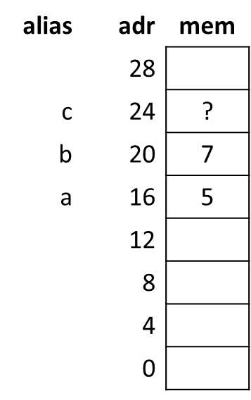
Variables and Memory

Slide 9
Variables and Memory
Definition <type> <name>
Example int counter
Two consequences The compiler
allocates memory somewhere in the process' memory space to hold the data (size of allocated memory = size of type)
creates a label <name> that allows us to conveniently reference this data

Slide 10
Variables and Memory
Example
compiler allocates
a to address 16
b to address 20
c to address 24
usually, but not guaranteed to be sequential
variable names are aliases for memory addresses
int a = 5, b = 7, c;
alias | adr | mem
 | 28
c | 24 | ?
b | 20 | 7
a | 16 | 5
 | 12
 | 8
 | 4
 | 0
… = a + …
… = mem[16] + …
a = …
mem[16] = …

Slide 11
Variables and Memory
Kernel virtual memory
Where is the data allocated in memory?
global variables
data/rodata/bss section
local variables
user stack
dynamically allocated data
heap
what about function parameters?
int a = 5;
const int b = 7;
int c;
int foo(int a, int b)
{
int e, f, g;
char *m = malloc(10); }
User stack
(created at runtime)
Unused
%rsp
(stack
pointer)
Memory-mapped region for
shared libraries
brk
Run-time heap
(created by malloc)
Read/write segment
(.data, .bss)
Loaded from
executable
Read-only segment
(.init, .text, .rodata)
0

Slide 12
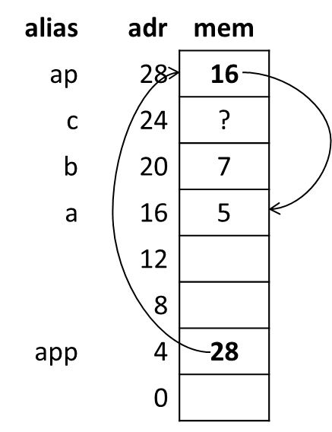
Pointers and Memory Allocation

Slide 13
Pointers
Variable names are aliases to memory addresses
we do not know what the address is directly
Pointers are explicit memory addresses
if we need to allocate memory dynamically or
want to know where in memory an address is
Pointers are used to refer to arrays

Slide 14
Pointers
Example: explicit address
compiler allocates
a,b,c at addresses 16,20,24
ap at address 28
ap itself is allocated somewhere in memory
int a = 5, b = 7, c;
int *ap = &a;
alias | adr | mem
ap | 28 | 16
c | 24 | ?
b | 20 | 7
a | 16 | 5
 | 12
 | 8
 | 4
 | 0

Slide 15
Pointers
Example: explicit address (cont’d)
compiler allocates
a,b,c at addresses 16,20,24
ap at address 28
ap itself is allocated somewhere in memory
compiler allocates
app at address 4
int a = 5, b = 7, c;
int *ap = &a;
alias | adr | mem
ap | 28 | 16
c | 24 | ?
b | 20 | 7
a | 16 | 5
 | 12
 | 8
app | 4 | 28
 | 0
…
int **app = &ap;
…

Slide 16
Dynamic Arrays
alias | address | mem
 | 0xffff c1ac
 | 0xffff c1a8
A | 0xffff c1a4 | ?
 | 0xffff c1a0
 |  | …
 |  | …
 | 4
 | 0
Example: dynamic arrays
compiler allocates
A at address 0xffff c1a4
int *A;

Slide 17
Dynamic Arrays
alias | address | mem
 | 0xffff c1ac
 | 0xffff c1a8
A | 0xffff c1a4 | 5655 0004
 | 0xffff c1a0
 |  | …
 | 0x5655 1004
A[1023] | 0x5655 1000
…
A[2] | 0x5655 000c
A[1] | 0x5655 0008
A[0] | 0x5655 0004
 | 0x5655 0000
 |  | …
 | 4
 | 0
Example: dynamic arrays
compiler allocates
A at address 0xffff c1a4
C standard library allocates sizeof(int)(=4 bytes) * 1024 = 4096 bytes = 0x1000 bytes on heap and and stores address of memory block in A
int *A;
…
A = (int *)malloc(sizeof(int)*1024);
…

Slide 18
Arrays, Pointers, and C
The handling of arrays and pointers is often confusing for beginners
Dynamically allocated arrays are pointers p is a pointer to the data of p[512] p[0] refers to the first element of array p &p[0] denotes the address of the first element of p and is identical to p
Statically allocated arrays are also treated as pointers buf is a pointer to the data of buf[512] buf[0] refers to the first element of array buf &buf[0] denotes the address of the first element of buf and is identical to buf
char *p = malloc(512 * sizeof(char));
char buf[512];

Slide 19
Arrays, Pointers, and C
The handling of arrays and pointers is often confusing for beginners Dynamically allocated arrays vs statically allocated arrays
#include <stdio.h>
#include <stdlib.h>
int main(int argc, char *argv[])
{
char buf[512] = { 'A', 'B', 'C', };
printf(" buf: %14p\n", buf);
printf(" buf[0]: %14c\n", buf[0]);
printf(" &buf[0]: %14p\n", &buf[0]);
printf("\n");
char *p = (char*)malloc(512 * sizeof(char));
p[0] = 'A'; p[1] = 'B'; p[2] = 'C';
printf(" p: %14p\n", p);
printf(" p[0]: %14c\n", p[0]);
printf(" &p[0]: %14p\n", &p[0]);
printf("\n");
free(p);
return EXIT_SUCCESS;
}
$ make arraysNpointers
gcc -o arraysNpointers arraysNpointers.c
$ ./arraysNpointers
buf: 0x7ffc3cc9f610
buf[0]: A
&buf[0]: 0x7ffc3cc9f610
p: 0x561f5fc0b6b0
p[0]: A
&p[0]: 0x561f5fc0b6b0
arraysNpointers.c

Slide 20
Arrays, Pointers, and C
The handling of arrays and pointers is often confusing for beginners Test your understanding:
char buf[512];
… = read(fd, buf, sizeof(buf));
char *buf = (char*)malloc(512*sizeof(char));
… = read(fd, buf, 512*sizeof(char));
NOT sizeof(buf)!
#define BUFSIZE 512
char *buf = (char*)malloc(BUFSIZE*sizeof(char));
… = read(fd, buf, BUFSIZE*sizeof(char));
char buf;
… = read(fd, &buf, sizeof(char));
NOT buf!

Slide 21
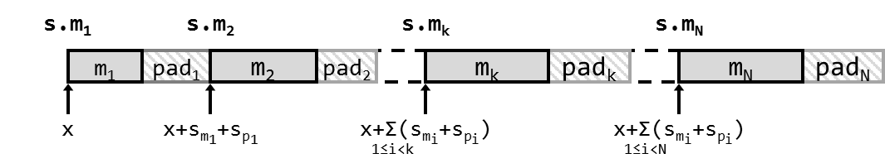
Data Types and Alignment

Slide 22
Data Types at the Machine Level
Integer data of 1, 2, 4, 8, or 16 bytes
Data values
Addresses (untyped pointers)
Floating point data of 4, 8, or 16 bytes
These days: vector data types
No aggregate types such as arrays or structures
Just contiguously allocated bytes in memory

Slide 23
Data Types
C Data Type | Size (bytes)
 | Typical 64-bit | x86-64 | Intel IA32
char | 1 | 1 | 1
short | 2 | 2 | 2
int | 4 | 4 | 4
long | 8 | 8 | 4
long long | 8 | 8 | 8
float | 4 | 4 | 4
double | 8 | 8 | 8
long double | 8 | 10/16 | 10/12
* (pointer) | 8 | 8 | 4
__[u]int128_t | 16 | 16 | -

Slide 24
Data Alignment
Alignment of data
rules regarding the location of data in the memory of a computer system
required on some machines; advised on IA32
treated differently by IA32 Linux, x86-64 Linux, and Windows!
basic rule
primitive data type requires K bytes → address must be K-byte aligned
K-byte aligned = address divisible by K
example:
4-byte integers must be located at addresses divisible by 4
valid addresses: 0, 4, 8, 12, 16, …
invalid addresses: 1,2,3,5,6,7,9,10,11,…

Slide 25
Data Alignment
Motivation for aligning data
memory accessed by (aligned) chunks of 4 or 8 bytes (system dependent)
inefficient to load or store datum that spans quad word boundaries
virtual memory management tricky when datum spans 2 pages

Slide 26
x86-64 Data Alignment Conventions
Base rule
primitive data type of K bytes should be K-byte aligned
Exceptions
10-byte primitive type (long double, extended): 16-byte aligned
Size (bytes) | Primitive Data Type | Alignment
 |  | Linux | Windows
1 | char, … | 1 | 1
2 | short, … | 2 | 2
4 | int, float, … | 4 | 4
8 | long, long long, *, double, … | 8 | 8
16 | __int128_t, long double, … | 16 | 16

Slide 27
IA32 Data Alignment Conventions
Base rule
primitive data type of K bytes should be K-byte aligned
Exceptions
10-byte primitive type (long double, extended): 4-byte aligned
8-byte primitive types (double, long long): 4-byte aligned on Linux, 8-byte aligned on Windows
Size (bytes) | Primitive Data Type | Alignment
 |  | Linux | Windows
1 | char, … | 1 | 1
2 | short, … | 2 | 2
4 | int, long, *, float, … | 4 | 4
8 | long long, double, … | 4 | 8
12 | long double, … | 4 | 4

Slide 28
Example: Size & Alignment of Primitive Types
Finding out about sizes and alignments on your machine
#include <stdio.h>
#define SIZE(t) sizeof(t)
#define OFS(v) ((unsigned long)&v.data - (unsigned long)&v)
#define INFO(t) { struct { char dummy; t data; } s; \
printf("%-15s %2zu %2lu\n", #t, SIZE(t), OFS(s)); }
void main(void)
{ printf("DATATYPE SIZE ALIGNMENT\n");
INFO(char);
INFO(short);
INFO(int);
INFO(long);
INFO(long long);
INFO(float);
INFO(double);
INFO(long double);
INFO(void *);
}
size.c
Macro-expansion generates the following code pattern:
void main(void)
{ printf("DATATYPE SIZE ALIGNMENT\n");
{ struct { char dummy; char data; } s; printf("%-15s %2zu %2lu\n",
"char", sizeof(char), ((unsigned long)&s.data - (unsigned long)&s)); };
{ struct { char dummy; short data; } s; printf("%-15s %2zu %2lu\n",
"short", sizeof(short), ((unsigned long)&s.data - (unsigned long)&s)); };
…

Slide 29
Example: Size & Alignment of Primitive Types
Finding out about sizes and alignments on your machine
$ gcc –m64 –o size.64 size.c
$ ./size.64
DATATYPE SIZE ALIGNMENT
char 1 1
short 2 2
int 4 4
long 8 8
long long 8 8
float 4 4
double 8 8
long double 16 16
void * 8 8
$
$ gcc –m32 –o size.32 size.c
$ ./size.32
DATATYPE SIZE ALIGNMENT
char 1 1
short 2 2
int 4 4
long 4 4
long long 8 4
float 4 4
double 8 4
long double 12 4
void * 4 4
$

Slide 30
Maintaining Data Alignment
Alignment rules upheld by compiler / assembly programmer
location of each variable according to alignment rules
gaps (padding) inserted as needed
also within composite data structures (structs, arrays, unions)
compiler knows the target architecture
generates a layout that is compatible with the architecture’s ABI
As programmers, we don’t need to worry too much about data alignments
However, once we go to the system/assembly level, they become relevant!

Slide 31
Data Alignment of Variables
#include <stdio.h>
int i = 1;
char c = 1;
…
void info(char *v, size_t s, void *adr, void *prev, size_t ps)
{
long pad = prev ? (long)adr - (long)prev - ps: 0;
printf("%-15s %2zu %16p %ld\n", v, s, adr, pad);
}
int main(void)
{
printf("Alignment of global variables\n\n");
printf("VARIABLE SIZE ADDRESS PADDING\n");
info("int i", sizeof(i), &i, NULL, 0);
info("char c", sizeof(c), &c, &i, sizeof(i));
…
info("long l", sizeof(l), &l, &ld, sizeof(ld));
printf("\n\n");
foo();
return 0;
}
varalign.c

Slide 32
Data Alignment of Variables
$ gcc –m64 –o varalign64 varalign.c
$ ./varalign64
Alignment of global variables
VARIABLE SIZE ADDRESS PADDING
int i 4 0x56183b8ac040 0
char c 1 0x56183b8ac044 0
short s 2 0x56183b8ac046 1
long long ll 8 0x56183b8ac048 0
char c2 1 0x56183b8ac050 0
char c3 1 0x56183b8ac051 0
float f 4 0x56183b8ac054 2
char c4 1 0x56183b8ac058 0
double d 8 0x56183b8ac060 7
long double ld 16 0x56183b8ac070 8
long l 8 0x56183b8ac080 0
…
$
varalign.c

Slide 33
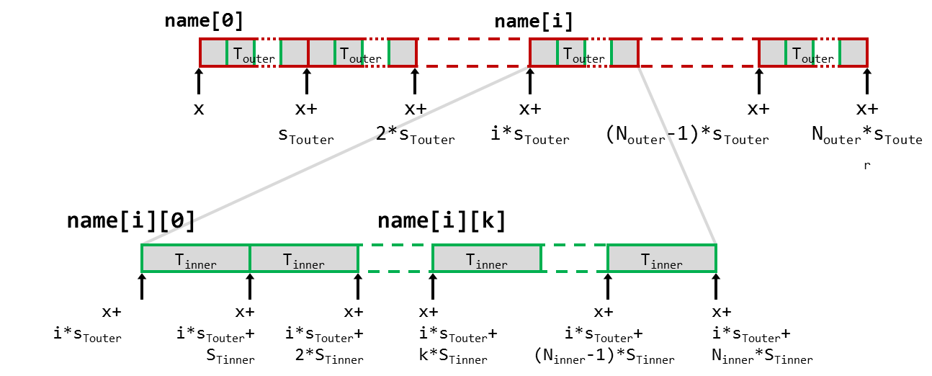
Composite Data Structures

Slide 34
Arrays
Declaration
<T> name[<N>]
Size
one element: s_{T} = sizeof(T)
entire array: s_{A} = N * s_{T}
Memory layout
Address of i-th element
adr_{i} = name + i*s_{T}
name[0]
name[2]
name[N-1]
T
T
T
T
x
x+s_{T}
x+2*s_{T}
x+3*s_{T}
x+(N-1)*s_{T}
x+N*s_{T}

Slide 35
Structures
Declaration
struct name { <T₁> <m₁>; <T₂> <m₂>; … <T_{N}> <m_{N}>; };
Memory layout
consecutive memory region containing all members m_{i} in-order, non-overlapping, and properly aligned
s.m₁
s.m₂
s.m_{k}
s.m_{N}
m₁
pad₁
m₂
pad₂
m_{k}
pad_{k}
m_{N}
pad_{N}
x
x+s_{m1}+s_{p1}
x+Σ(s_{mi}+s_{pi})
x+Σ(s_{mi}+s_{pi})
1≤i<k-1
1≤i<N-1

Slide 36
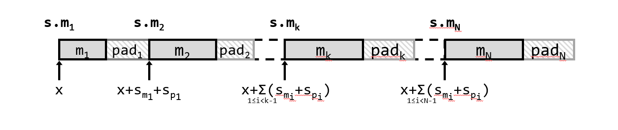
Structures
Address of k-th member
start of struct plus sum of sizes of all 1..k-1 members and paddings
Adr_{mk} = x+Σ(s_{mi}+s_{pi})
Size of struct
s_{s} = Σ(s_{mi}+s_{pi})
the last padding (pad_{N}) is chosen such that the size of the struct is the next multiple of the biggest alignment requirement of any of its members
this comes in handy when declaring arrays of structs (all elements of the array will be automatically aligned)
1≤i<k-1
1≤i≤N

Slide 37
Example: Arrays of Structures
struct S2 {
double v;
int i[2];
char c;
} a[10];
Overall structure length multiple of K
Satisfy alignment requirement for every element
 | a[0] |  |  |  |  | a[1] |  |  |  |  | a[2] |  |  |  |  | • • •
a+0 |  |  |  |  | a+24 |  |  |  |  | a+48 |  |  |  |  | a+72
 | v |  |  |  |  |  |  | i[0] |  |  |  | i[1] |  |  |  | c | 7 bytes
a+24 |  |  |  |  |  |  | a+32 |  |  |  |  |  |  |  | a+40 |  |  |  |  |  |  |  | a+48

Slide 38
Unions
Declaration
union name { <T₁> <m₁>; <T₂> <m₂>; … <T_{N}> <m_{N}>; };
Memory layout
consecutive memory region containing all members m_{i}, and properly aligned
all members are located at offset 0 and overlap in memory
s.m₁, …, s.m_{N}
s.m_{k}
s.m_{N}
s.m₂
s.m₁
m₁
m₁
m₂
m₂
m_{N}
m_{k}
x
m_{k}
m_{N}
x

Slide 39
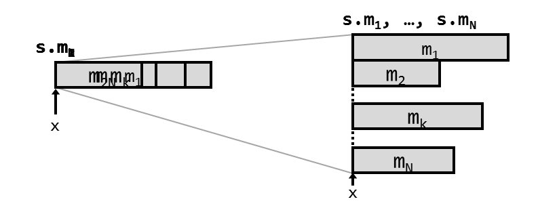
Unions
Alignment
union alignment = maximum alignment requirement of any of its members
Address of k-th member
start of union
adr_{mk} = x
Size of union
s_{u} = max(s_{mi})
1≤i≤N

Slide 40
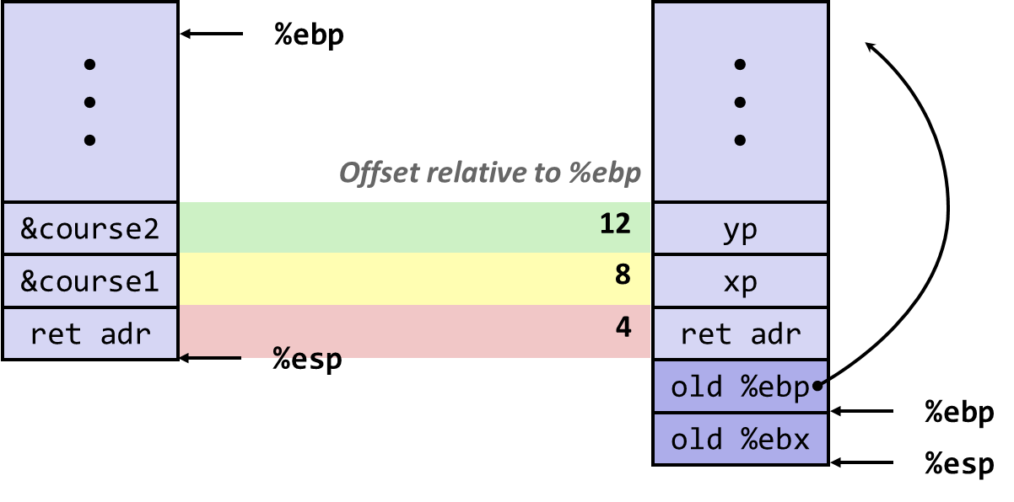
Parameter Passing

Slide 41
Parameter Passing
Caller vs callee
caller the function calling another function
callee the function being called
Caller can pass arguments to the callee
two ways
pass by value
pass by reference
int foo(int a, int b) { a = 2*a;
return a + b; }
int bar(void)
{
int x = 5, y = 6, z; z = foo(x, y);
}

Slide 42
Parameter Passing
Pass by value
pass a copy of the value to the callee
modifications to arguments local to callee
scalar types are passed by value
address space of foo
alias | adr | mem
b | … | 6
a | … | 5
int foo(int a, int b) { a = 2 * a;
return a + b; }
int bar(void)
{
int x = 5, y = 6, z; z = foo(x, y);
}
pass copy of values
address space of bar
alias | adr | mem
z | … | ?
y | … | 6
x | … | 5

Slide 43
Parameter Passing
Pass by reference
instead of passing a copy of the value, a copy of the value's memory address is passed to the callee
modifications to arguments affect original values
address space of foo
alias | adr | mem
b | … | 6
*a | … | 100
int foo(int *a, int b) { *a = 2 * *a;
return *a + b; }
int bar(void)
{
int x = 5, y = 6, z; z = foo(&x, y);
}
pass copy of
memory address
address space of bar
alias | adr | mem
z | … | ?
y | … | 6
x | 100 | 510

Slide 44
Parameter Passing
Pass by reference
instead of passing a copy of the value, a copy of the value's memory address is passed to the callee
access via memory address or directly via register visible in assembly code
address space of foo2
alias | adr | mem
b | … | 6
*a | … | 100
int foo2(int *a, int b) { *a = 2 * *a;
return *a + b; }
pass copy of
memory address
address space of bar2
alias | adr | mem
z | … | ?
y | … | 6
x | 100 | 510
0000000000000000 <foo2>:
0: mov (%rdi),%eax # load a(=5)
2: add %eax,%eax # 5+5
4: mov %eax,(%rdi) # store a=(10)
6: add %esi,%eax # b + 2* *a
8: ret

Slide 45
Parameter Passing
Pass by reference
arrays are always passed by reference
makes sense: we know that arrays are treated as pointers in C
address space of foo
alias | adr | mem
*a | … | 200
pass a copy of
array location
int foo(int *a) { a[2] = 5;
}
int bar(void)
{
int x[10] = {0,1,2,3,4,5,6,7,8,9}; printf("%d", x[2]); // prints 2
foo(x);
printf("%d", x[2]); // prints 5
}
address space of bar
alias |  | adr | mem
 | x[9] |  | 9
 | … |  | …
 | x[2] |  | 25
 | x[1] |  | 1
x | x[0] | 200 | 0

Slide 46
Parameter Passing
Pass by reference
arrays are always passed by reference
makes sense: we know that arrays are treated as pointers in C
access via memory address visible in assembly code
address space of foo3
alias | adr | mem
*a | … | 200
pass a copy of
array location
int foo3(int *a) { a[2] = 5;
}
address space of bar3
alias |  | adr | mem
 | x[9] |  | 9
 | … |  | …
 | x[2] |  | 25
 | x[1] |  | 1
x | x[0] | 200 | 0
0000000000000000 <foo3>:
0: movl $0x5,0x8(%rdi) # mem[rdi+8]=5
7: ret

Slide 47
Parameter Passing
Command line parameters
command line parameters are passed to main
argc: number of arguments
argv[]: array of pointers to char (=strings)
argv[0] is the program name (i.e., argc >= 1)
int main(int argc, char *argv[])
{
int i;
for (i=0; i<argc; i++) {
printf("argv[%d] = '%s'\n", i, argv[i]);
}
return 0;
}

Slide 48
Summary
Summary
-------------
-------------
-------------
-------------
-------------
-----

Slide 49
Variables and Memory
Data types and alignments are machine specific
Programming languages map to machine data types
Alignment requirements are taken care of by the compiler
Composite data types only exist in high-level languages
The machine only knows scalar (and vector) data types
Constant data types are mapped to contiguous blocks of memory
Offsets of fields computed and managed by the compiler
Variables are labels to the actual memory address where the data is stored
Pointers are variables that contain memory addresses
Parameter passing between functions
Passing by value = passing a copy of the data
Passing by reference = passing the memory address of the data

